Slide 1
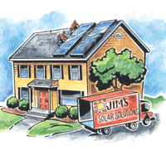
Solar Energy – energy from the Sun
The Earth gets heat and light energy from the sun all the time. Can we use it – yes we can! The Sun’s energy can either be:
changed into electrical energy to use in homes, using solar cells;
or used to heat water for homes, using solar panels.
Renewable
No pollution, because nothing gets burned
Solar cells and solar panels are expensive
Only works if it’s sunny!

Slide 2

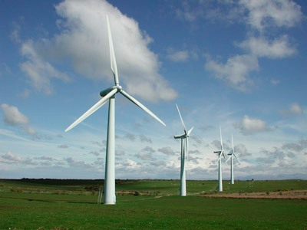
Wind Energy – energy from the wind
Using wind turbines, we can turn the movement energy of the wind into electrical energy which we can use in our homes. This is ‘wind energy’.
Renewable
No pollution, because nothing gets burned
Turbines are quite cheap and easy to build, so they can be used even in poor countries
Turbines can be ugly and noisy
Only works if it’s quite windy! If the wind stops, you get no energy.

Slide 3
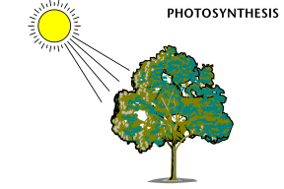
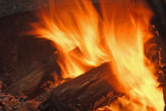
Biomass Energy – energy from plants
The chemical energy stored in things that were once alive (e.g. trees) can be turned into heat energy by burning them. (We can also turn it into electrical energy to use in our homes.)
Trees absorb the sun’s energy. The trees change this energy into chemical energy, which they store inside themselves.
When we burn wood, we turn this energy into heat, which is useful for cooking and heating.
Renewable – as long as we keep planting trees to replace the ones we cut down
Doesn’t need any special equipment, so it can be used very easily, even in poor countries
Doesn’t add to the greenhouse effect
Large areas of land are needed to grow enough trees

Slide 4
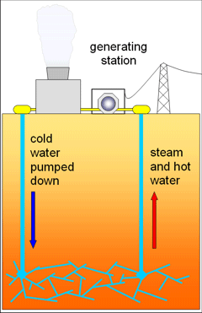
Geothermal Energy – energy from the Earth
Deep underground, the Earth’s rocks are naturally very hot. We can turn their heat energy into electrical energy to use in our homes – we call this ‘geothermal energy’.
Cold water is pumped below the ground.
Hot rocks heat the water, turning it into steam.
The steam is used to generate electricity.
Renewable
No pollution, because nothing gets burned
Doesn’t damage the environment
Very few places in the world where you can do this
Costs a lot of money to drill deep into the ground

Slide 5
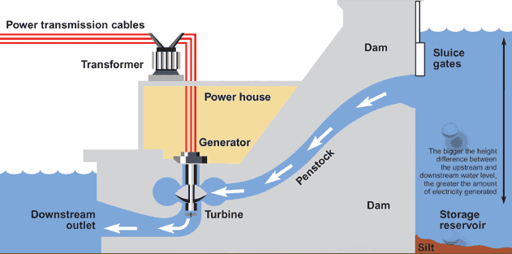
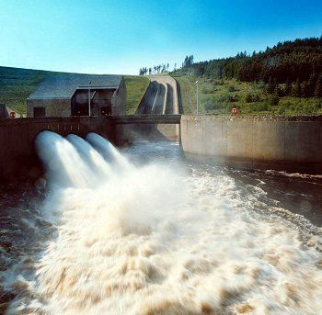
Hydroelectric Energy – energy from rivers
The water flowing in a river has movement energy. We can turn this into electrical energy to use in our homes. We usually need to build a dam, and let the water flow through it gradually.
Renewable
No pollution, because nothing gets burned
We can store the water up high, and then whenever we need the energy we can let the water out
Costs a lot of money to build a dam
The dam can ruin the local environment, because it changes where the water naturally flows. Some animals and plants may die.

Slide 6
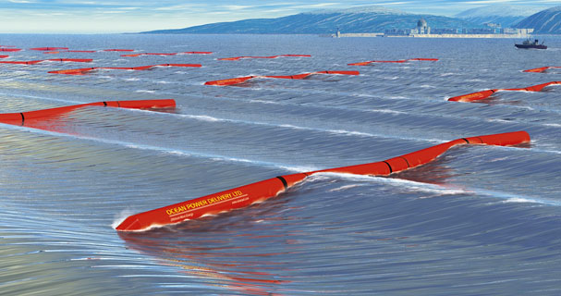
Wave Energy – energy from sea waves
The sea’s waves have movement energy. Using machines that bob up and down in the waves, this energy can be turned into electrical energy which we can use in our homes.
wave energy machines bobbing up and down in the waves
Need lots of machines to get a reasonable amount of energy
The machines costs a lot of money
The machines can look ugly
The machines can be damaged by storms
Renewable
No pollution, because nothing gets burned

Slide 7
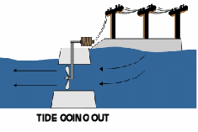
Tidal Energy – energy from sea tides
If you’ve ever been to the coast, you may have noticed that the sea level goes up and down, because of tides. When the tide is high, the water has lots of gravitational potential energy, which we can turn into electrical energy to use in our homes.
At high tide, we trap the water behind a dam.
At low tide, the water is released, and its energy is used to generate electricity.
Renewable
No pollution, because nothing gets burned
Reliable, because there are always two tides every day
Cheap to run, once it’s built
Costs a lot to build the dam
The dam may cause local flooding

